Slide 1
SHUBAN BISWAS
2024111017
Precog NLP Task Report

Slide 2
Tasks Completed:
Task 0 : The Library of Babel
Class 1, 2, 3 Dataset extracted/generated
Topics and metadata Extracted
Task 1 : The Fingerprint (and some Extras*)
Type Token Ratio, Hapax Legomena, Measure of Textual Lexical Diversity*, Sentence Length Standard Deviation*, Adjective Noun Ratio, Dependency Tree Depth, Flesch Kincaid, Discourse Connective Density*, Punctuation Density, PCA of Function words*.
Task 2 : The multi tiered Detective (and some Extras*)
The Statistician (XGBoost), The Semanticist (Feedforward NN), The Transformer (LoRA fine tuning),
The Contrastive (Triplet Loss)*, The Variance (Sentence Transitions)*, The Structure (2D Heatmaps)*
Task 3 : The smoking gun
Utilized Permutation Importance and Attention Analysis.
Identified specific "AI isms" and checked few fail cases.
Task 4 : The Turing Test
Basic Genetic Algorithm to bypass detectors.
Tested on personal writing.
Task 5 ? Extras
Understanding the Human mind for punctuation use
Interpreting Language models for punctuation use
New method for bypassing Detectors

Slide 3
Pre Data Extraction thought process
Questions:
How to make sure all authors have similar datas (To reduce number of “core topics”)
We need Diverse data, and try not to be period specific (Model shouldn’t learn wrong stuff)
Picking 100-200 words from Novels will inevitably be choppy, and incomplete.
AI data needs to be as close (and diverse) as Humans without over prompting.

Slide 4
HUMAN DATA - PROJECT GUTENBERG
4 Authors from different eras/styles, All are “Essays” extraction, not Novels:
Francis Bacon 1597 (The Essays or Counsels, Civil and Moral)
Ralph Waldo Emerson 1841 (Essays by Ralph Waldo Emerson)
William James 1907 (Pragmatism: A New Name for Some Old Ways of Thinking)
Bertrand Russell 1912 (The Problems of Philosophy)
Extraction:
Remove metadata and artifacts
Split into Chapter Blocks and Assign a topic (Ethics & Conduct, General Philosophy, Mind & Knowledge, Religion & Spirit, Society & Politics, Truth & Reality)
Sentence tokenize, accumulate chunks at 100-200 words (150 ideally)
Assign metadatas and push into a parquet file

Slide 5
AI DATA - GEMINI API
Count number of per author, per topic Human data, so the AI data’s distribution is similar
AI is prompted to output 800-1000 words, and then we run same cleaning and chunking algorithm of Humans to bring it down to 100-200 words, keeping the same “choppy and incomplete” feel.
Gemini 3 uses a unique well formatted structure to make it easier for AI detectors. Hence we use 3 free models: Gemini 3 flash, Gemini 2.5 flash, Gemini 2.5 flash lite.
Class 2 Data is only given topics, while class 3 is prompted to mimic author style.

Slide 6
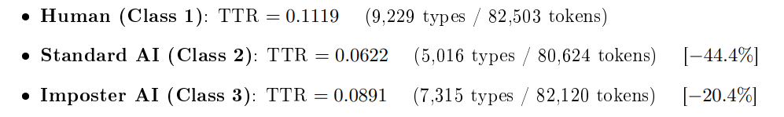
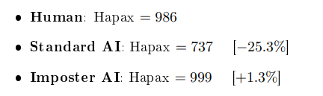
TTR = number of unique word types/ total number of word tokens.
It seems like Humans have more variance in their vocabulary, Except Russell (TTR 0.098) other humans have TTR greater than 0.17
Hapax shows the number of times “Single Use” words show up in a 5000 word window
Even though LLMs are trained on Human input, this variance imbalance occurs due to biases towards high frequency words, more familiar by the model.
Humans on the other than use idiosyncratic creative choices and jargons from experiences.
Even though both follow Zipf's Law, the parameters are distinct enough for high accuracy classifiers due to “linguistic homogenization” effect of LLM
(“Comparative Statistical Analysis of Word Frequencies in Human-Written and AI-Generated Texts” Kudryavtseva et al 2025)

Slide 7
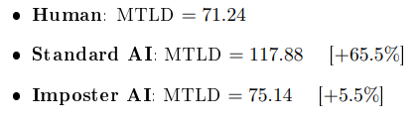
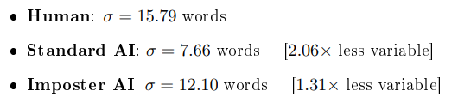
Measure of Textual Lexical Diversity (MTLD) computes the average length of sequential word strings that maintain a TTR at or above a threshold.
Higher MTLD means, the text sustains lexical diversity over longer spans before words begin to repeat. This is a better representation of TTR, as it is invariant of text length.
AI actually tries too hard to sound diverse, waiting about 118 tokens before repeating words, while humans reuse terms every 71 tokens; most probably for emphasis or "vocabulary fatigue".
(“MTLD, vocd-D, and HD-D: A validation study of sophisticated approaches to lexical diversity assessment” McCarthy et al 2010)
Higher Sentence Length Standard Deviation means more rhythmic variety, mix of short and long sentences.
Here we can observe a major difference of humans and ai, (more about this is studied in Extras Section at the end)

Slide 8
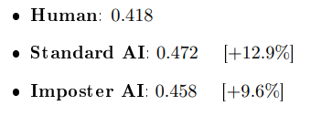
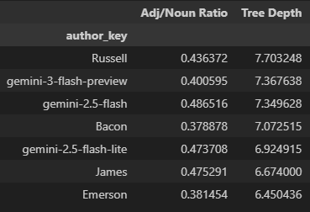
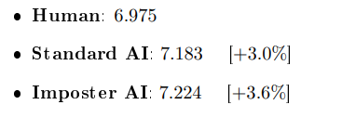
Ratio = Count(ADJ tags)/Count(NOUN tags), computed per row using spaCy's dependency parser and averaged per group.
Over adjectifying in LLMs doesn’t come from Pre Training, but RLHF fine tuning while trying to align the model as an “helpful assistant”. This behaviour sticks even if asked to mimic humans.
(“Word Overuse and Alignment in Large Language Models: The Influence of Learning from Human Feedback” Juzek et al 2025)
Average maximum depth of syntactic dependency parse trees per sentence, computed using spaCy. If you see per author, this doesnt seem to have any significant difference from human to ai. Everyone has their own natural writing style and the LLMs seem to learn and stick to the average of this behavior.
Interestingly gemini 2.5 flash lite seems to be worse than the flash models, this might be due to superposition and interference of active features (As discussed in Extra Section in the end).

Slide 9
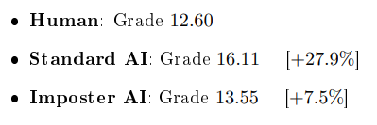
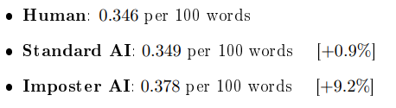
Flesch Kincaid Grade Level = 0.39 words/sentences + 11.8 syllables/words − 15.59 (Estimates the US school grade level required to comprehend the text. Higher values indicate more complex prose).
Grade 16 is comparable to graduate level academics, while 12.6 is roughly at college level. The difference is minimal if you compare by author (as previous one). Humans have a more variant writing style.
(“Derivation Of New Readability Formulas (Automated Readability Index, Fog Count And Flesch Reading Ease Formula) For Navy Enlisted Personnel” Kincaid et al 1975)
Count of discourse markers (however, therefore, furthermore, thus, hence, etc.) per 100 words, computed per row and averaged is Discourse Connective Density.
As we can see, Imposter AI tries to overcorrect how “Humans” think by trying to make human like transitions through its own thought process, which again comes down to models choosing more predictable and stable words to carry over transitions properly.
(“Ghostbuster: Detecting Text Ghostwritten by Large Language Models” Verma et al 2024)

Slide 10
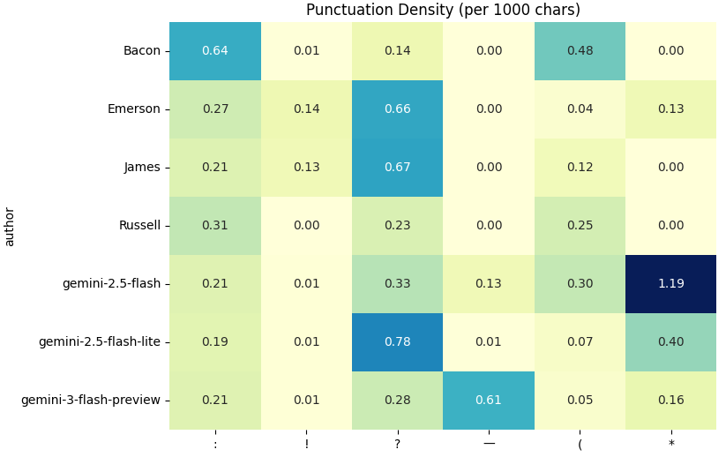
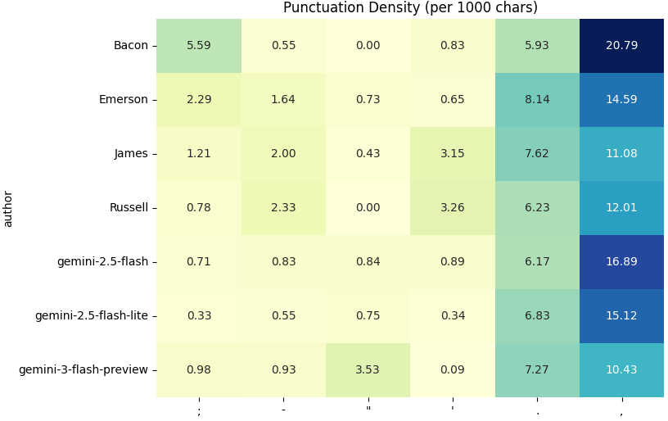
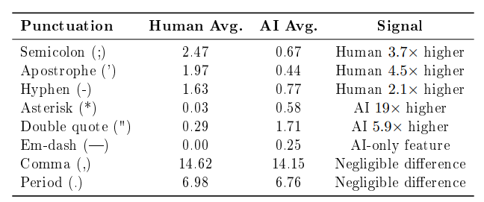
Em-dash, double quotes and asterisks weren’t popular among the authors I selected, it seems, they did use hyphen and apostrophe instead for same purpose. Semicolon is a weird outlier due to Bacon. Most interesting feature is Comma, Period; seem to be in similar range overall, but have vast differences per author. As we will see in Extras in the end, there are a lot of differences in placements of these punctuations even though frequency seems similar

Slide 11
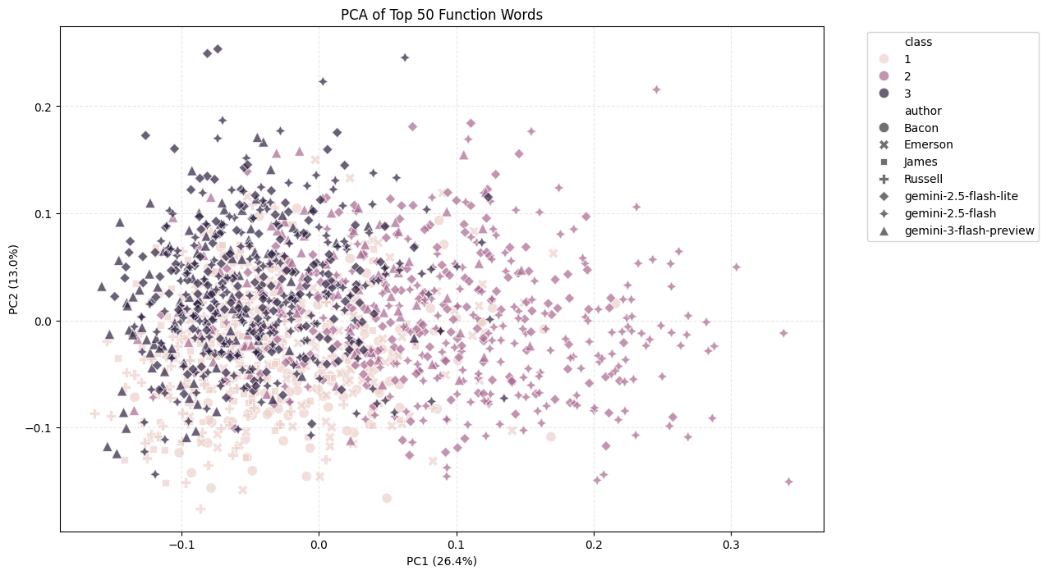
extracted the top 50 most frequent function words (ltered against spaCy's stop word list), computed their relative frequencies per text, and projected the resulting 50 dimensional space to 2 dimensions via PCA.
LLMs fails to replicate syntactic variance, clustering exclusively in negative PC1 values while human authors extend deep into the positive axis. This shows AI normalizes prose into standard patterns, effectively stripping the idiosyncratic density of function words (connectives, prepositions) that define an author's unique fingerprint. The models capture the topic, but flatten the structural complexity, unable to mimic the humans even when prompted.

Slide 12
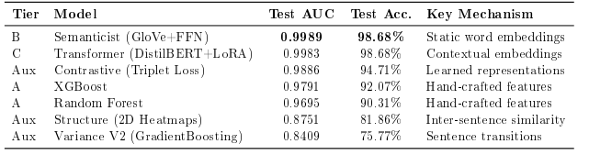
Tested the 6 different approaches
3 which were from Task 2 showed better than expected results. While 3 custom ones was less than promising
During implementation, the Dataset was divided into 3 categories randomly (Train, Validate, Test), ratios varied based on the model. Validate was mostly used to tune the hyperparameters on Train, and Test results were kept blind till the end.
Note: Given Test dataset was often 15% samples of 1500, it might not be “fair” due to outliers. I just kept XGBoost in Statistician.

Slide 13
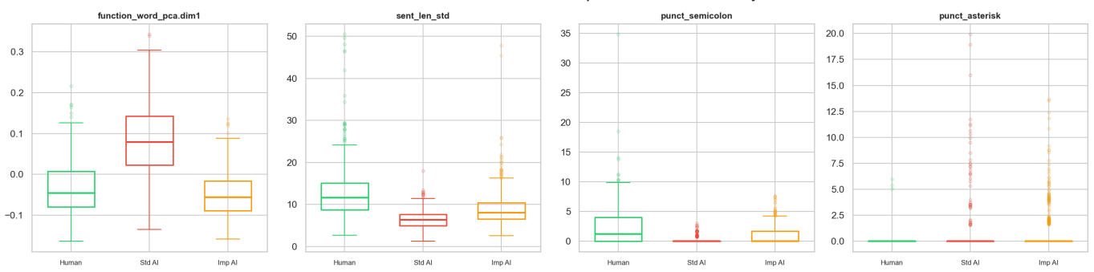
Statistician
Algorithm: XGBoost (“XGBoost: A Scalable Tree Boosting System” Chen et al 2016) 1000 estimators, learning rate 0.05, max depth 6, early stopping at 50 rounds Top 5 important features : (Semicolon, PCA, MTLD, String Length Standard deviation, Asterisk)
This model was a nice middle ground among all the models with 93.83% accuracy. XGBoost excels at finding nonlinear decision boundaries in feature space. This ran quicker than the other models as it’s just running data through a series of if else logics, basically dropping the input down 1000 distinct decision trees to tally up a final vote.

Slide 14
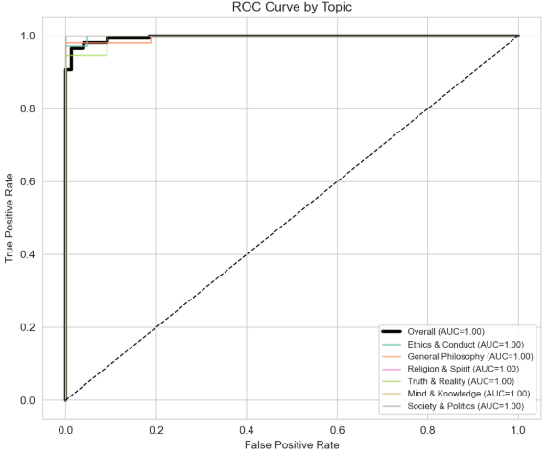
Semanticist
GloVe is deliberately context free, each word maps to exactly one vector regardless of context. This tests whether AI and human texts differ in their average word semantics, independent of how words are arranged. (“GloVe: Global Vectors for Word Representation” Pennington et al 2014)
With a near perfect 0.9989 AUC, it's clear LLM text lives in its own "semantic neighborhood". Since AI relies on a predictable vocabulary, easy to spot. Gemini 2.5 and 3 use different embedding models, and it seems GloVe figured it; looking at syntax or context is almost unnecessary for this Dataset. (This might what CopyLeaks use in their AI detection, Hence the outlier in Extras section at the end).
Society & Politics is the only topic with AUC < 1.0. This topic has the highest TTR (0.223) and sentence length variation (14.68) among all topics. Maybe this diversity caused the false negative.

Slide 15
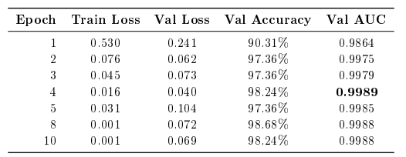
Transformer
DistilBERT ("DistilBERT, a distilled version of BERT" Sanh et al 2019) keeps 97% of BERT's power while being 40% smaller making it light enough to fine-tune on a laptop 4GB GPU.
LoRA ("LoRA: Low-Rank Adaptation of Large Language Models" Hu et al. 2022) reduces trainable parameters from 66M to just 887K by freezing the main model and using low-rank matrices.
This scored second best in Test with a negligible margin. The Transformer captures contextual patterns, long-range dependencies, and attention patterns that static features cannot. However, GloVe results suggesting that vocabulary choice is the dominant signal and syntactic/contextual information provides negligible additional benefit, and might be an overkill for non altered LLM text.

Slide 16
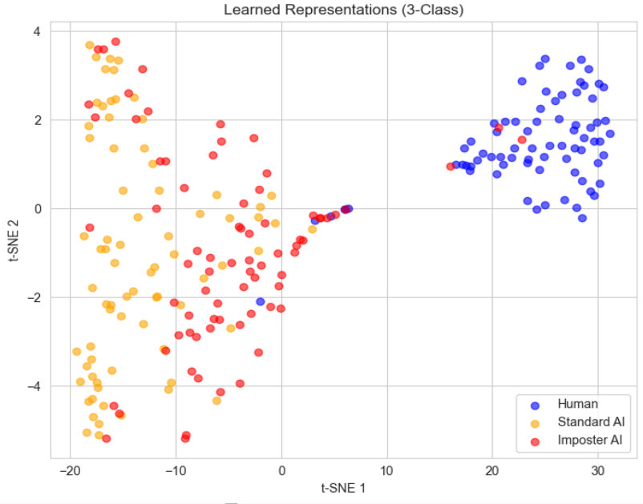
Contrastive
The contrastive model tests whether learned representation, outperform pre trained embeddings. Inspired by SimCLR (“A Simple Framework for Contrastive Learning”, Chen et al 2020) and triplet networks (“FaceNet”, Schroff et al 2015).
Despite task specific training, the Contrastive model (AUC 0.9886) underperforms the Transformer (AUC 0.9983). The likely cause is that sentence level MiniLM embeddings discard sub sentence patterns (word-level attention, local syntax) that DistilBERT preserves. The triplet loss also requires careful tuning of margin and mining strategy. I didn’t test more as GloVe and other methods showed promising results already.

Slide 17
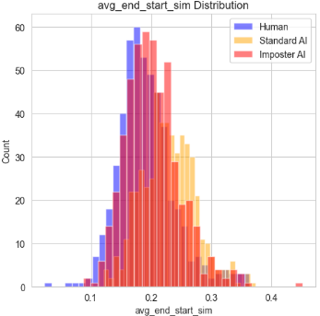
Variance
The Variance model tests an intuition about how LLMs generate text: since they predict the next token, their sentence to sentence transitions should be smoother and more predictable than human transitions. by measuring semantic similarity, topic gradients, vocabulary overlap across sentence boundaries, burstiness in sentence length, etc.
The intuition is confirmed but quantitatively weak: AI text is measurably smoother and more uniform than human writing, consistent with autoregressive generation. AI demonstrates higher inter sentence similarity (avg_full_sim: 0.587 vs. 0.521) and distinct vocabulary bleeding across boundaries (avg_boundary_overlap: 0.241 vs. 0.183). While these feature distributions clearly separate, the signal provides only a modest differentiator at the individual text level. Also given the small samples (100-200 words) the variance was extremely noisy from sentence to sentence :(

Slide 18
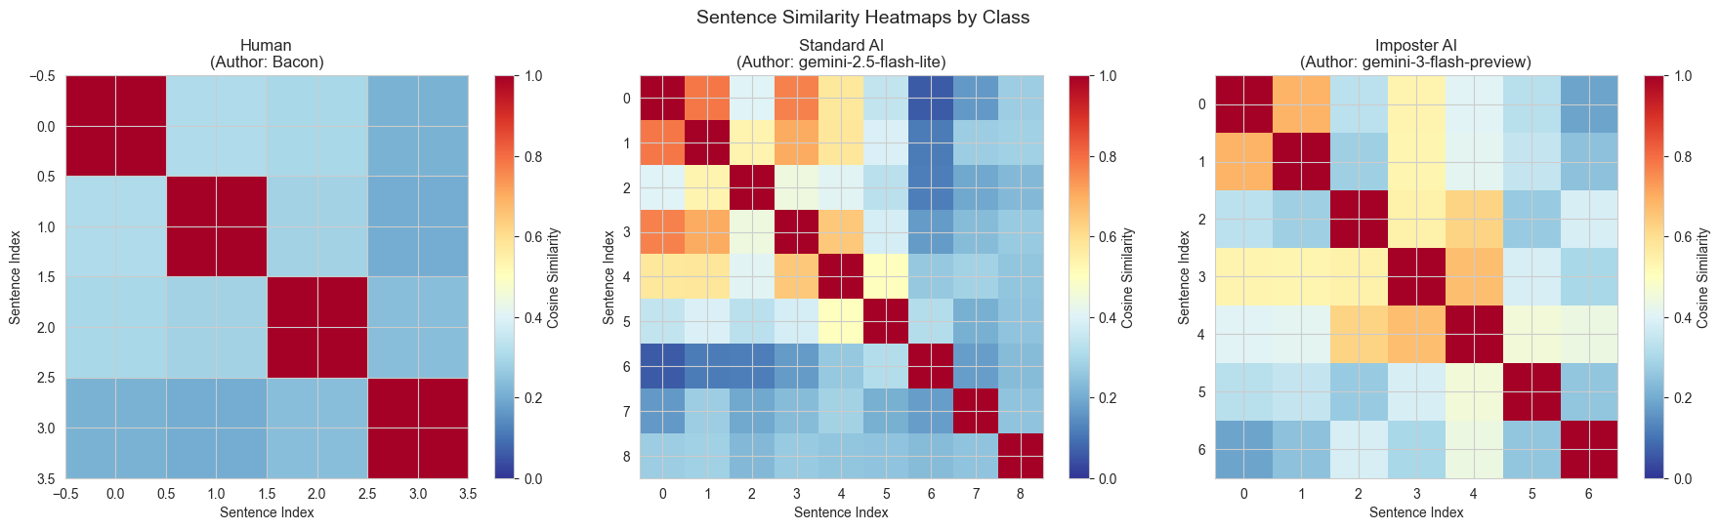
Structure
After Variance (neighbors only) I did full 2D heatmaps, seeking a "structural fingerprint". Intuition: Human writing is modular. bright thematic blocks separated by rhetorical pivots. AI is "hyper coherent", Driven by attention mechanisms to maximize context, it produces a uniformly bright matrix, effectively smoothing over the sharp conceptual edges typical of human thought.
In hindsight analyzing unstructured 100 word fragments (median 8x8 matrices) meant global structure simply didn't exist; we used context slicing in data collection. But it wasnt absolutely bad, AI still showed a sentence to sentence coherence (the yellow parts) more than human on average. Giving 81% AUC.

Slide 19
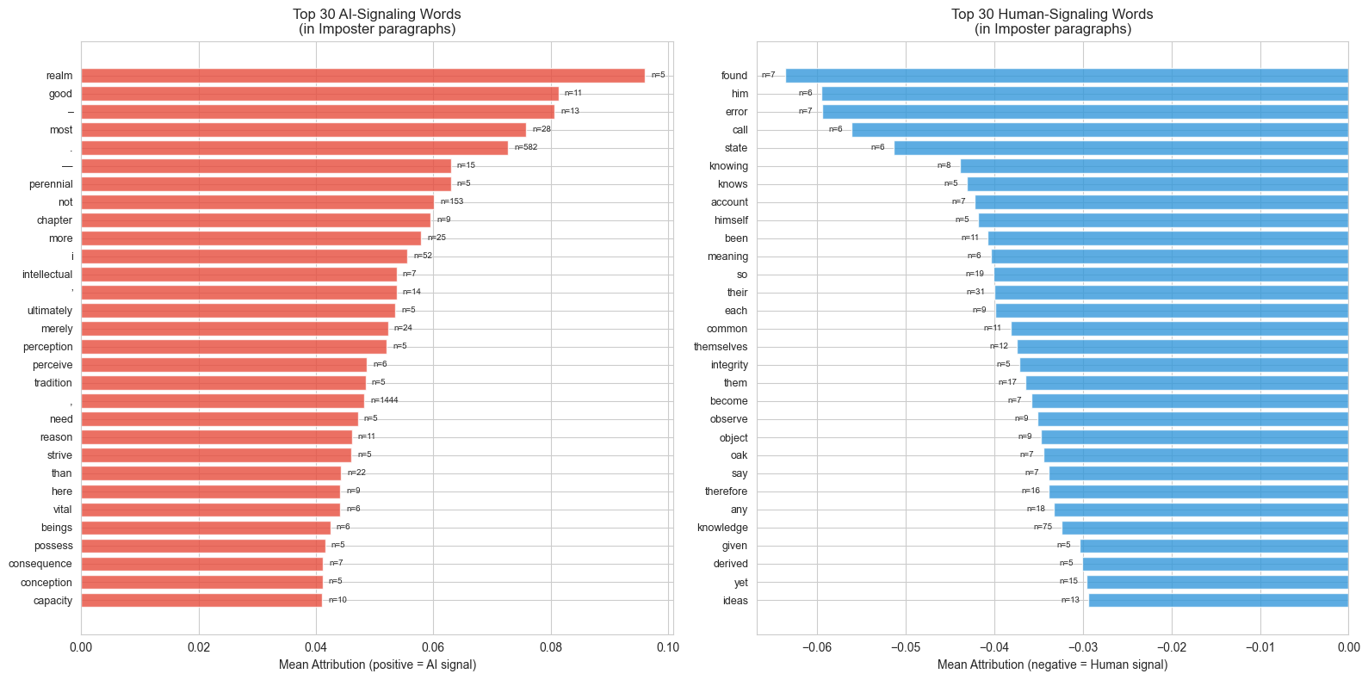

Slide 20
Overall Understanding
To peer inside the black box of the Transformer's 12 attention heads, we applied Captum's Integrated Gradients to the embedding layer, revealing that the model relies on a mix of punctuation microstructure, and a specific dictionary of triggers rather than just abstract rhythm. Token level attribution highlights that abstract connective tissues like "realm", "perennial" and "ultimately" (100% positive) alongside explicit negation are the strongest signals for AI, while "humanity" is flagged by narrative anchors like third person pronouns ("him", "themselves") and concrete, messy nouns like "error" or "oak". Punctuation is equally critical: the model treats em-dashes and high frequency periods as "sophistication markers" for AI, which is interesting for Extras section later
This settles the Vocabulary vs Rhythm understanding: the Statistician (XGBoost) tracks the macro rhythm (sentence length consistency), while the Transformer exploits micro "AI-isms." The "AI-isms" are usually functional words like "merely" or "intellectual" that signal a specific kind of hyper coherent discourse. Conversely, the False Negatives engage mimicking Authors archaic vocabulary to override these standard signals, proving that style transfer can effectively blind the model to the underlying generative rhythm.

Slide 21
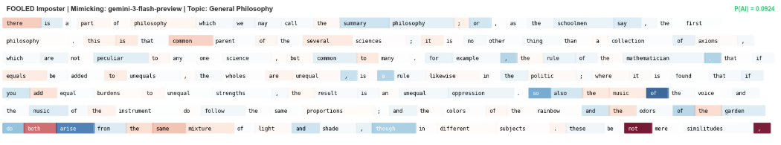
False Positives
Three cases where Humans were labeled as AI (False Positives), the authors were indeed being repetitive or hyper formal, Emerson’s Ethics & Conduct (P=0.983) was flagged because he engaged in an enumerative catalogue listing literary works with such monotone sentence structures that he dropped all semicolons and apostrophes, perfectly mimicking AI’s lack of punctuation variety. A second Emerson sample (P=0.927) triggered the detector through graduate level formality using Latinate vocabulary and long continuous sentences that statistically resembled an LLM's output. Finally, William James’s Truth & Reality (P=0.850) fooled the model by sustaining high vocabulary diversity without his semicolons as usual.

Slide 22
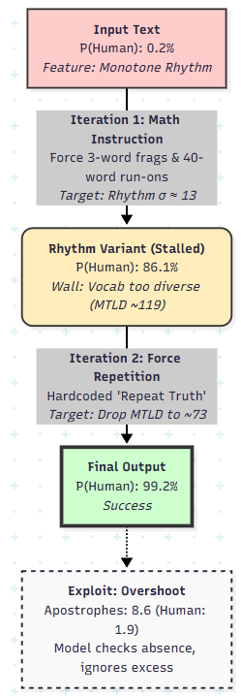
Simple Genetic Algorithm
The pipeline used Feature Guided Mutation. Instead of asking the AI to rewrite, we calculated exactly which number gave it away (eg, "Your MTLD is 119, it needs to be 73") and sent a mathematical instruction to the LLM.
Iteration 1 : Forced the model to mix 3 word fragments with 40 word run ons. This fixed the monotone signal instantly. Hit a wall because the AI refused to be repetitive enough (AI is trained to avoid repetition).
Iteration 2 : Hardcoded Instruction for the AI to repeat the words. This crashed the diversity score (MTLD) to human levels. (Cheat will only work on this detector, and paragraph loses meaning significantly)
Rhythm is key: target approx 13 words/sentence (Standard AI is stuck at ~6). Vocabulary: humanize by forcing repetition, drop MTLD from AI's ~119 to human's ~73. Punctuation: inject "messy" features (2.5 semicolons/1k chars, heavy contractions). Readability: lower the grade from Graduate (16.1) to College (12.6). Copy Prompt: Stylistic Mimicry (Like class 3) shifts all these simultaneously.
The final text also used 4x more apostrophes than a normal human, but since the detector only looks for the absence of contractions, it labeled this as definitely human. We can dig deeper into this and only concentrate on punctuations in Extra section

Slide 23
Issues
The system is not perfect, It is 84% confident my SOP is standard AI (which is not true, it's completely handwritten start to end). MTLD (lexical diversity): 119.33, TTR: 0.713 (could be due to short and diverse SOP), Sent len std: 12.82 (closer to human mean but still borderline), Flesch Kincaid grade: 15.33 (higher complexity, wanted to sound cool).
If we had more context windows (500 words instead of 100-200), I would expect GloVe’s accuracy to go down, due to more range of words being used by Humans and AI, making both use more of “each other’s words”. And other Model’s accuracy to go up due to more data.
It’s easy to get False Positives and False Negatives, inherently the detector will be biased towards quality, fairness and closeness of its data; The Simple Genetic Algorithm is not meant to be submission ready Humanizer, it’s to prove a point that with very simple instructions you can “over humanize” a text and fool even the best detectors.

Slide 24
EXTRAS
Task 5? Understanding Punctuation Use in Text

Slide 25
Pre-Internet Literature
Commas help Humans read like they speak.
Humans decide a place for full stop, not where the “syntax” is complete, but when the “Prosodic Contour” (Melody of Sentence) feels resolved.
(“Punctuation and Implicit Prosody in Silent Reading: An ERP Study” Steinhauer et al 2016)
Punctuations acts as a mental "speed bump", that forces you to process a thought before moving on.
Writers instinctively use these breaks, to keep the reader from feeling mentally overloaded.
("Commas and Spaces: The Point of Punctuation" Hill and Murray 2000)

Slide 26
Pre-Internet Literature
Punctuation usage follows the Principle of Least Effort. The frequency of full stops is inversely proportional to the effort required to process the chunk, Based on Short Term memory.
Sentence lengths typically follow a Log Normal Distribution.
("Frequency Distributions of Punctuation Marks in English" Sue et al 2018)
Thought Process:
These are the abundant resources available for training a Model.
And as we will see later, the rare “variance” in human writing (due to Log Normal Distribution) is even worse in AI even though the same data is used for training.

Slide 27
Internet Era Writing
Research shows that a full stop in messaging is often perceived as falling intonation, insincere, or passive aggressive, because texting lacks non verbal cues (facial expressions, tone of voice). ("Texting insincerely: The role of the period in text messaging" Gunraj et al 2016)
Studies noted a 30% reduction in punctuation marks (like the full stop) in semi formal digital contexts (like emails, Slack), where the Send button is often mentally accepted as “Period”.
("The Impact of Digital Communication on the Evolution of Writing Grammar" Yadagiri 2020)
Even though old text (Abundant for AI’s training data) have shown a decrease in commas (1800-2000), due to shift from longer to shorter sentences since Victorian Era.
In modern texts we use commas, to splice independent thoughts together, like a beating of heart in the sentence while we think, a habit which has carried through formal writing, like this sentence for example.
("Frequency Distributions of Punctuation Marks in English" Liu et al 2018) ("Txtng is killing language. JK!!!" Ted Talk John McWhorter 2013) (“Because Internet: Understanding the New Rules of Language” McCulloch 2019)

Slide 28
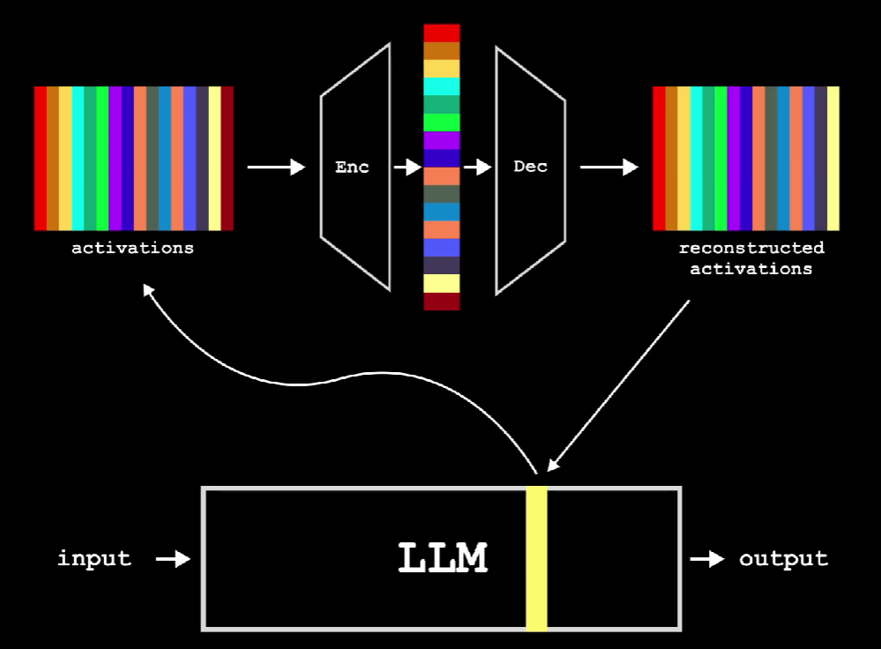
Then Comes… AI
Understanding Language models is a complex task. The best modern Researchers can do is use Sparse AutoEncoders (SAE).
A layer of an LLM contains more “Features” than “Neurons”. The same Neuron may “Activate” for vastly different purposes based on surroundings.
SAE helps disentangle these features, making models less of a “blackbox”.
Encoder and Decoder layers take a lot of Data, Compute and time to train even for a small gpt2 like model.
(“A Window Into LLMs | Sparse Autoencoders Explained” Youtube PapersAreWonderful 2024)

Slide 29
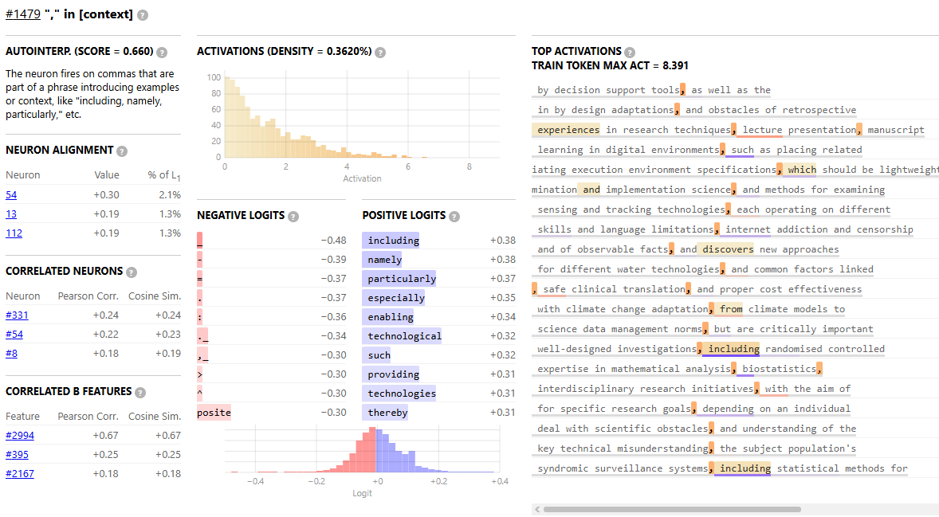
Anthropic: Towards Monosemanticity
Before Claude Sonnet 3, Anthropic analyzed and publicly released monosemantic features data on a smaller model.
Here for example, we can see feature #1479 forcing the model to take a “Statement-> Comma-> Elaboration” Response instead of vastly different punchy thoughts.
(https://transformer-circuits.pub/2023/monosemantic-features/index.html)

Slide 30
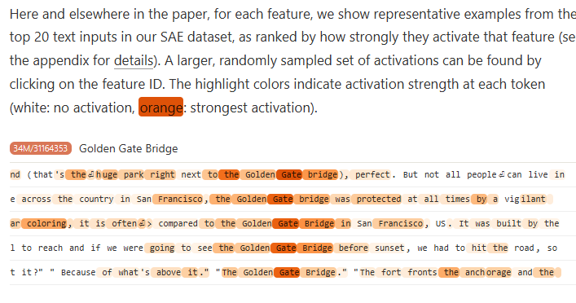
Problem with Short Sentences
Some features, like example “the Golden Gate bridge” activate late in the sentence. This shows model’s thoughts are not organized till later in the sentence when entropy is lower, which triggers other features like end of sentence.
In Sonnet 3 Researchers found "Context" features require certain number of tokens to charge up. If model ends sentence early, it results in decrease in confidence predicting the next sentence
(“Scaling Monosemanticity: Extracting Interpretable Features from Claude 3 Sonnet” Anthropic 2024)

Slide 31
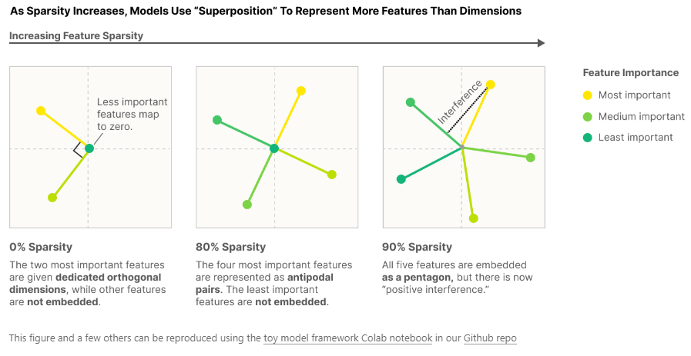
Problem with Long Sentences
When more features are active (long sentences, before model “resets” with Period), the angle between them degrade, and superposition doesn’t hold up.
Even though model might be trained on somewhat “variant” data (Human’s Log Normal Distribution), smaller models typically learn to output similar structure and length sentences.

Slide 32
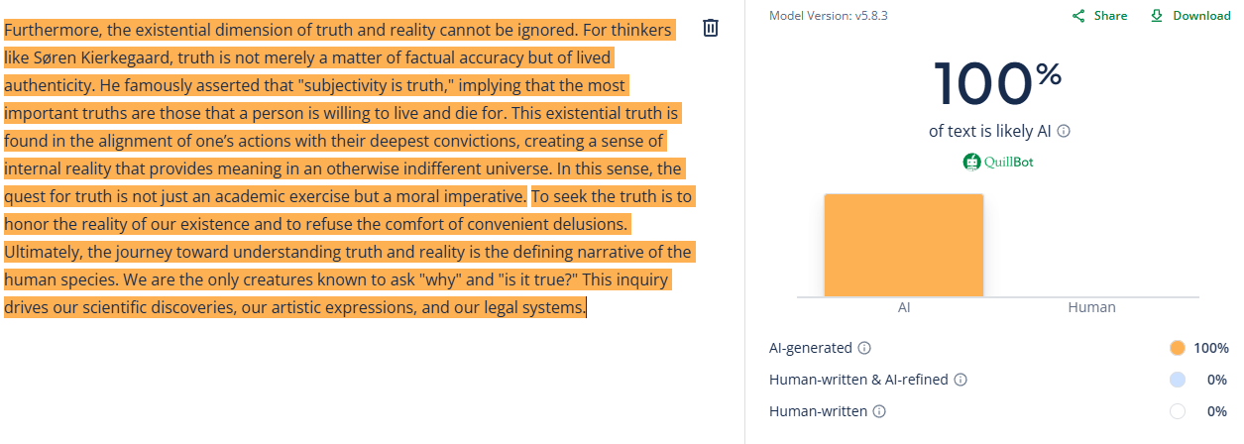
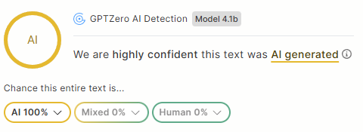
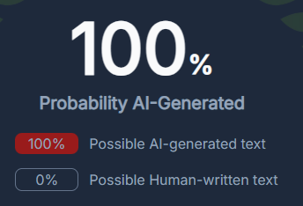
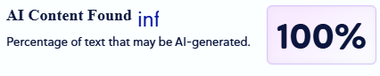
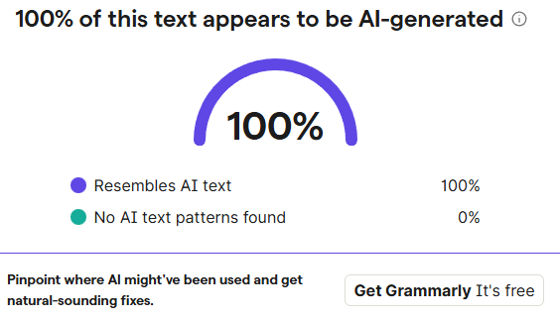
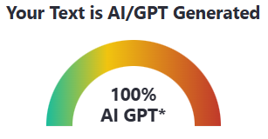
Example from Task 0 Data (Gemini 3 Flash)
Quillbot, GPTZero, CopyLeaks, ZeroGPT, Grammarly, NoteGPT all detect 100% AI

Slide 33
Humanizer Algorithm - Clause Assembler
Deconstruction: Uses Gemini API to parse text into atomic "thought units" scoring each for mental load and soundness
Probabilistic Assembly: Monte Carlo algorithm to restructure sentences lengths: Fragment (2-8 words), Run On (40-65 words), and Log Normal Distribution
Pattern Disruption: Aggressively alters rhythm by inserting intra clause commas, breaking parallel structures, and forcing random stops. (Trying to mimic Human thought process while writing a Post Internet era Text)

Slide 34
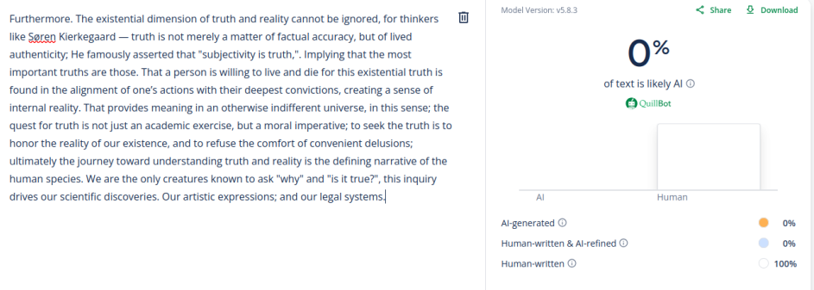
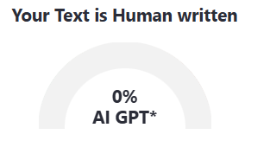
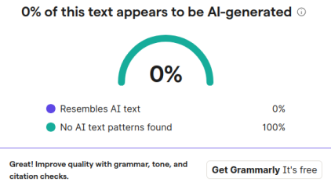
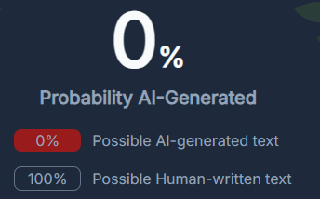
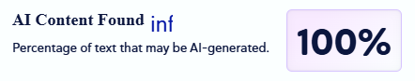
After changing Punctuation Style
CopyLeaks Still show 100%AI. Quill Bot shows 0-20% AI in multiple runs (Due to non deterministic algorithm).

Slide 35
Future Work
We have a lot of unanswered questions, and positive leads to continue this work.
Variance and Structure performed poor, due to the chopped up small dataset, but is promising as all LLMs suffer from this issue and it is difficult to Humanize more LLM instructions. Natural Punctuations led to methods trying to make the model fake thinking like a human.
We can continue with both of those ideas by using larger dataset (eg RAID), and possibly training a small Sparse Autoencoder looking for these high level features to interpret model thinking in a deeper level, to possibly steer the behaviours from sentence to sentence like a Human, rather than a Prediction Algorithm.

Slide 36
References
("Comparative Statistical Analysis of Word Frequencies in Human-Written and AI-Generated Texts" Kudryavtseva et al 2025)
("MTLD, vocd-D, and HD-D: A validation study of sophisticated approaches to lexical diversity assessment" McCarthy et al 2010)
("Word Overuse and Alignment in Large Language Models: The Influence of Learning from Human Feedback" Juzek et al 2025)
("Derivation Of New Readability Formulas (Automated Readability Index, Fog Count And Flesch Reading Ease Formula) For Navy Enlisted Personnel" Kincaid et al 1975)
("Ghostbuster: Detecting Text Ghostwritten by Large Language Models" Verma et al 2024)
("XGBoost: A Scalable Tree Boosting System" Chen et al 2016)
("GloVe: Global Vectors for Word Representation" Pennington et al 2014)
("DistilBERT, a distilled version of BERT" Sanh et al 2019)
("LoRA: Low-Rank Adaptation of Large Language Models" Hu et al 2022)
("A Simple Framework for Contrastive Learning" Chen et al 2020)
("FaceNet" Schroff et al 2015)
("Punctuation and Implicit Prosody in Silent Reading: An ERP Study" Steinhauer et al 2016)

Slide 37
References
("Commas and Spaces: The Point of Punctuation" Hill and Murray 2000)
("Frequency Distributions of Punctuation Marks in English" Sun et al 2018)
("Texting insincerely: The role of the period in text messaging" Gunraj et al 2016)
("The Impact of Digital Communication on the Evolution of Writing Grammar" Yadagiri 2020)
("Txtng is killing language. JK!!!" Ted Talk John McWhorter 2013)
("Because Internet: Understanding the New Rules of Language" McCulloch 2019)
("A Window Into LLMs | Sparse Autoencoders Explained" Youtube PapersAreWonderful 2024)
("Towards Monosemanticity: Decomposing Language Models With Dictionary Learning" Anthropic 2023)
(“Scaling Monosemanticity: Extracting Interpretable Features from Claude 3 Sonnet” Anthropic 2024)
AI tools for Researching, Prototyping, Debugging : Gemini, Github Copilot

Slide 38
THANK YOU :D

